Slide 1
Feedforward Network (Backpropogation)
Artificial Intelligence
October 30, 2019

Slide 2
Our Plan
W | 10/23/2019 | Neural Networks | Intro to Neural Networks
M | 10/28/2019 | Machine Learning | Quiz | Quiz 3 (Machine Learning)
W | 10/30/2019 | Neural Networks | Feedforward Networks (Backprop)
M | 11/04/2019 | Neural Networks | Recurrent Networks (Hopfield) | Assignment 3 (Machine Learning)
W | 11/06/2019 | Neural Networks | Self Organizing Maps
M | 11/11/2019 | Deep Learning | Deep Sequence Learning
W | 11/13/2019 | Neural Networks | Quiz | Quiz 4 (Neural Networks)

Slide 3
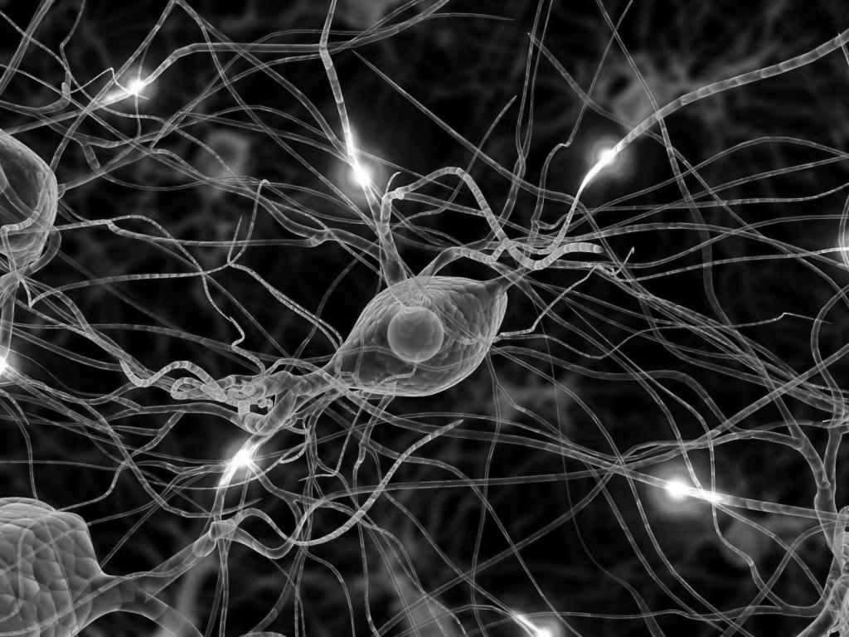
Artificial Neural Networks
Intro to ANNs and the Perceptron
Feedforward Networks (Backprop)
Recurrent Networks (Hopfield)
Self-organizing maps (Kohonen net)

Slide 4
Materials
Chapter 8 and 9 of Yoshimi
See PerceptronLearn.xlsx
Backpropagation.pdf worked example

Slide 5
Agenda
Review of perceptrons
Perceptron learning
Learning for multilayer perceptrons – backpropogation
In-class activity
Analysis of backpropogation
What do the hidden layer do?

Slide 6
review of perceptrons

Slide 7
Feedforward vs. Recurrent NNs

Slide 8
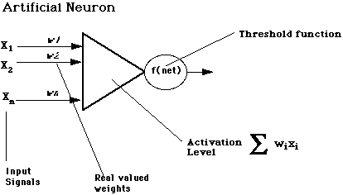
Computational model of a neuron (Perceptron - 1942)

Slide 9
perceptron learning rule

Slide 10
Perceptron Learning Algorithm
We are learning the connection weight
Start with random or zero weights
Compute output given input
Compute error by comparing actual output to desired output
Adjust weights using perceptron learning rule
Repeat until weights converge (very little change)

Slide 11
Perceptron Learning Rule
Δw_{ij} = w_{ij} + η a_{I} (t_{J} - a_{J})
a_{I} is the perceptron input
a_{J} is the perceptron output
t_{J} = is the target output
(t_{J} - a_{J}) is the error signal
η is a small constant (e.g. 0.1) called learning rate
Example
a_{I} = 1, t_{J} = 2; wij = 1, η = 0.5;
Δw_{ij} = 1 + 0.5 * 1 * (2 – 1) = 1.5

Slide 12
See PerceptronLearn.xlsx

Slide 13
learning in multilayer perceptrons (Backpropagation)

Slide 14
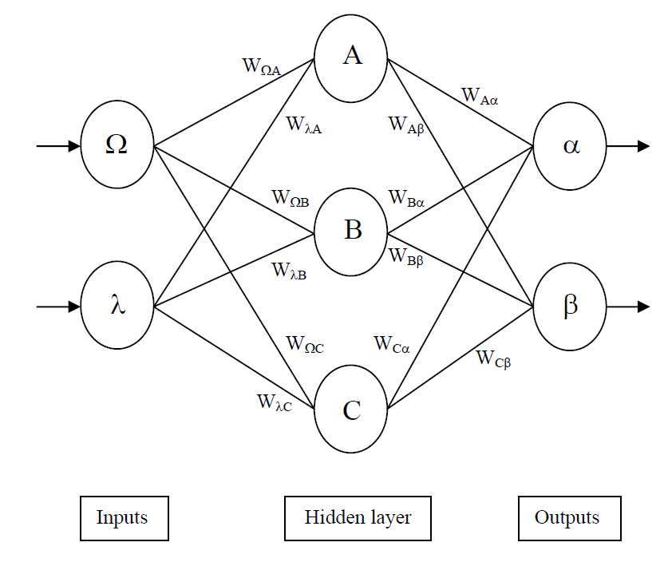
Multilayer perceptron (one or more hidden layers)

Slide 15
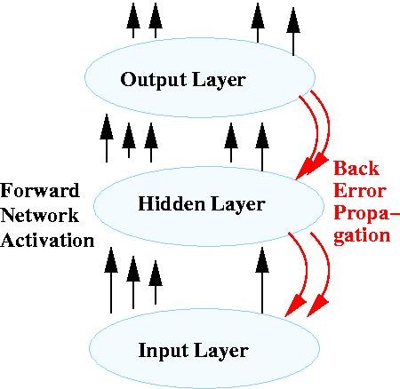
Backpropogation

Slide 16
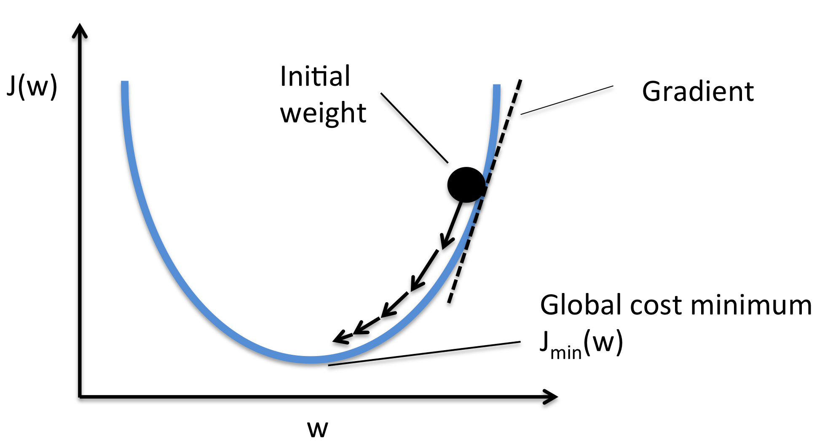
Gradient Descent

Slide 17
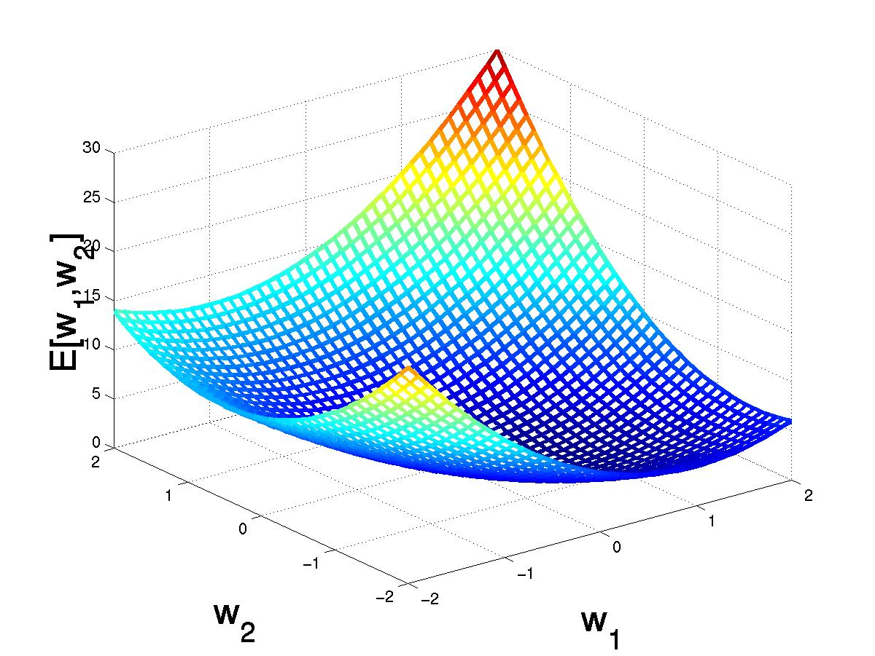
Gradient Descent
(w₁,w₂)
(w₁+Δw₁,w₂ +Δw₂)

Slide 18
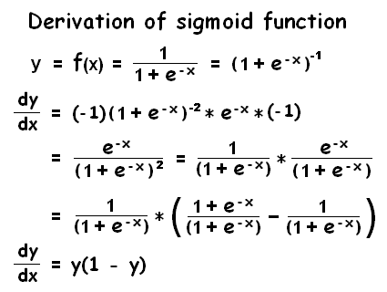
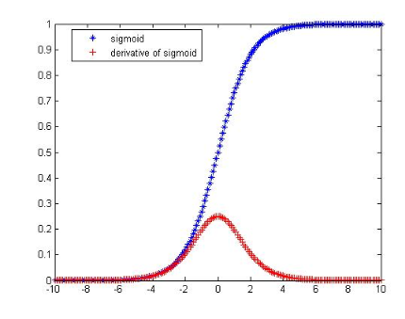
Derivative of Sigmoid

Slide 19
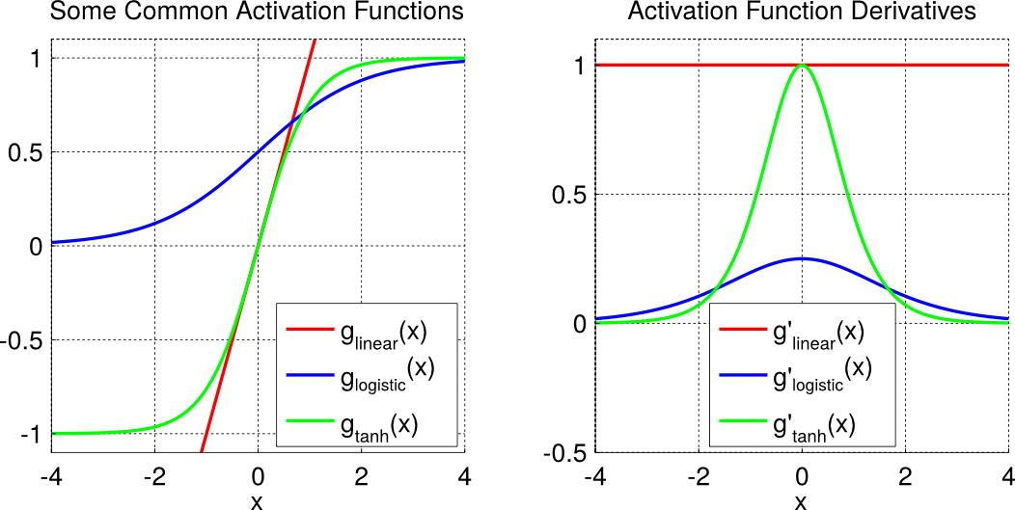
Other Activation Functions and their Derivatives

Slide 20
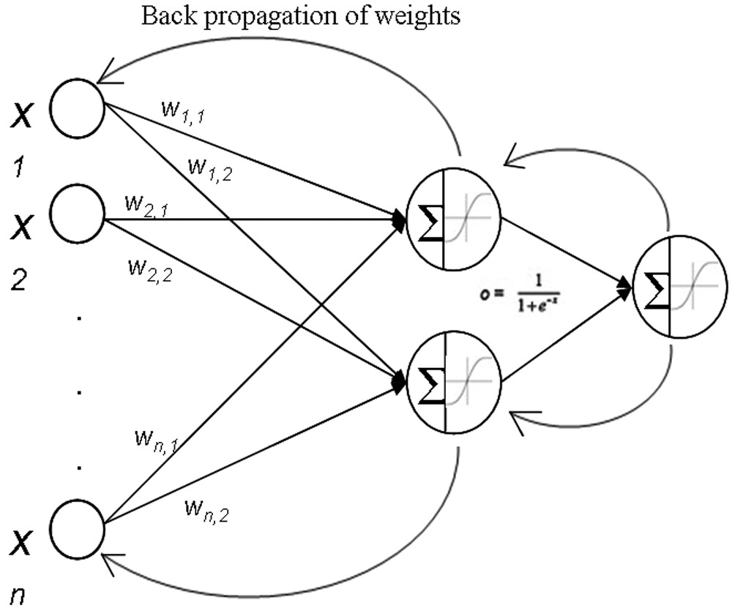
Algorithm
Start with random weights
2. For each input-output pair
Complete a forward pass
Compute error on output neurons
Used this to change weights on hidden layer
Estimate (backpropogated) error on hidden neurons
Used this to change weights on input layer
3. Repeated Step 2 until convergence (no weight change)

Slide 21
Backpropogation

Slide 22
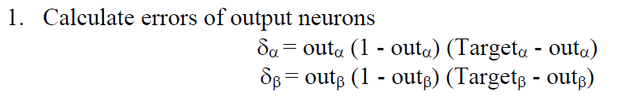
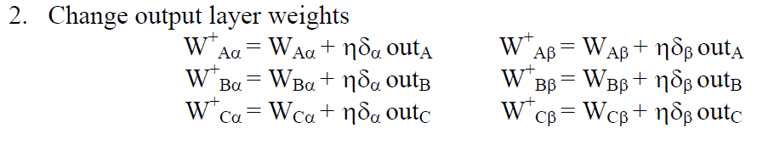
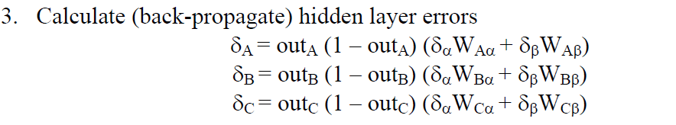
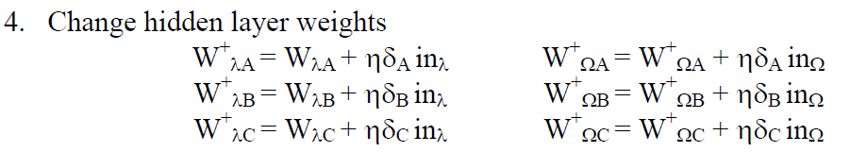

Slide 27
worked example

Slide 28
BackpropWorkedExample.pdf

Slide 29
in-class activity

Slide 30
analysis

Slide 31
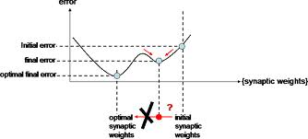
Limitations (Local Minima)

Slide 32
Momentum
Adds a percentage of the last movement to the current movement

Slide 33
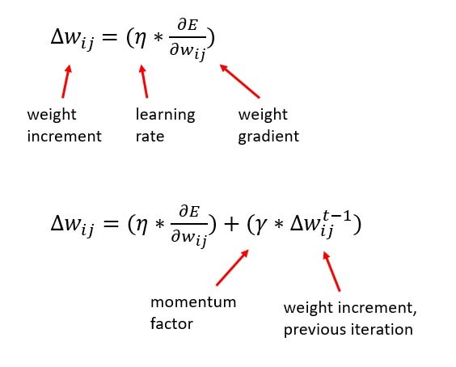
Momentum

Slide 34
what does the hidden layer do?

Slide 35
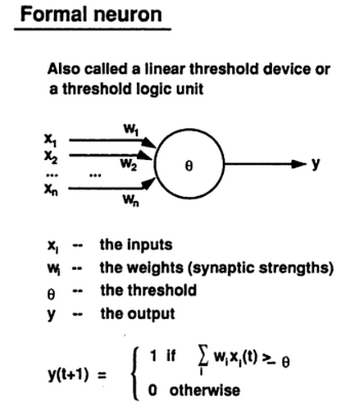
Consider perceptron with binary activation function

Slide 36
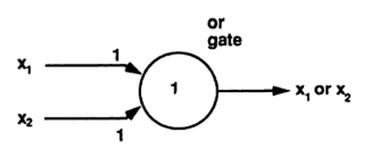
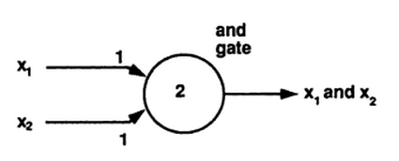
OR and AND Gates

Slide 37
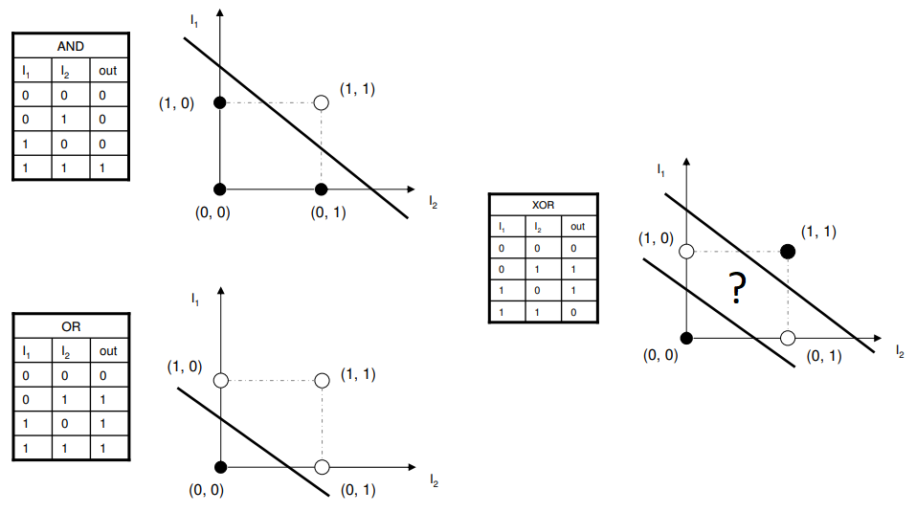
Perceptrons and Seperability
Or and And are linearly separable; Xor is not

Slide 38
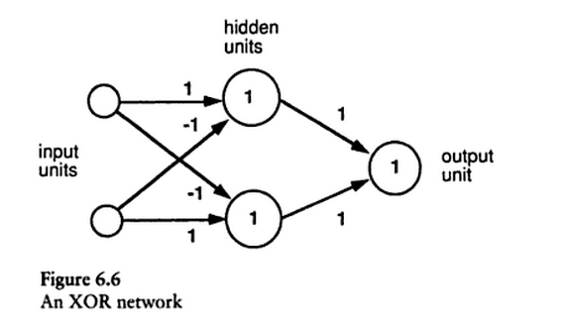
XOR with a multilayer perceptron
The hidden layer transforms the data so that XOR can be solved

Slide 39
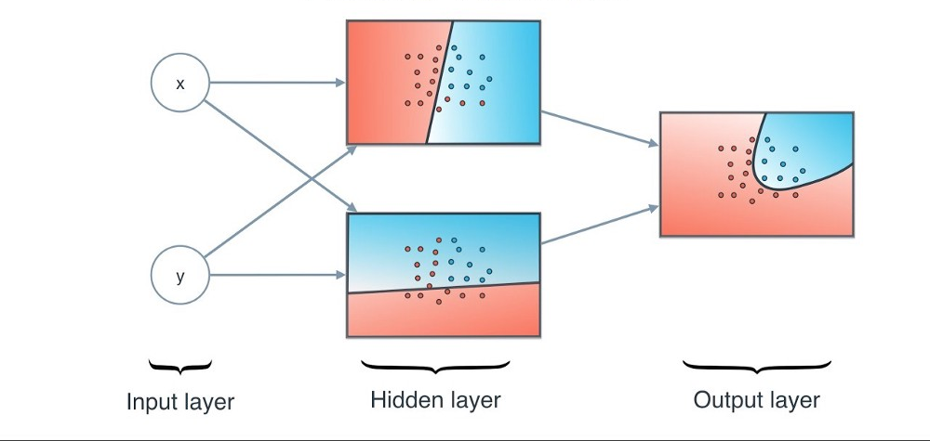
Nonlinear discriminations deeper into network

Slide 40
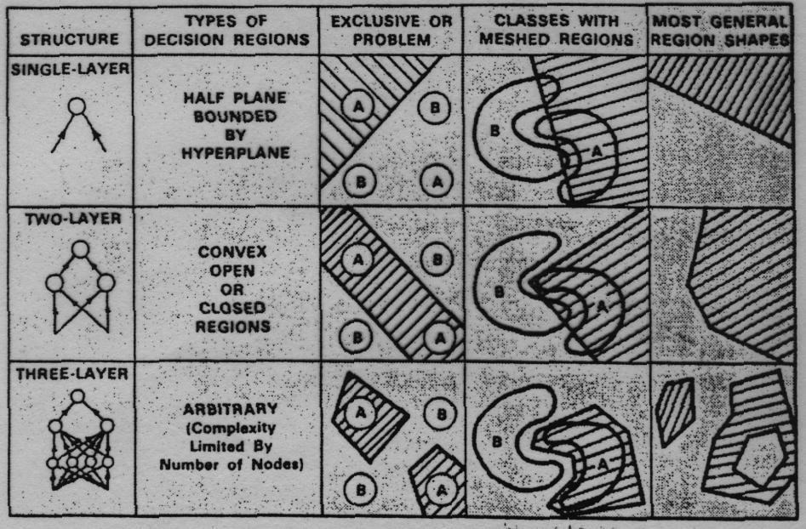
What different layers can achieve

